Slide 1
ZUDIO RETAIL SALES PERFORMANCE
ANALYTICS DASHBOARD
Project Documentation — SQL + Power BI Retail Analytics Project
Anantha Kumaravel R | Data Analytics, Anudip Foundation

Slide 2
Introduction and problem statement
This project turns raw Zudio retail data into simple, clear dashboards. It uses SQL to build and clean the database, and Power BI to create the visuals. The data is organized into five connected tables — Stores, Customers, Products, Orders, and Order Items — and the final result is four interactive dashboards.
The problem
The solution
Raw retail data in tables is hard to read and understand quickly.
Turn the data into a clear, visual dashboard anyone can use to understand business performance at a glance.

Slide 3
Objectives and tools used
Objectives
Tools and technologies
Collect and organize retail data into a clean structure
SQL
Build and clean the database
Clean the data before building any charts
Power Query
Clean and prepare the data
Build a structured SQL database with connected tables
Power BI
Build the interactive dashboards
Create DAX measures for sales, profit, orders, and products
Build four interactive Power BI dashboards
DAX
Create measures and calculations
Find useful patterns in sales, products, stores, and customers
CSV
Store and import the dataset

Slide 4
Dataset and table relationships
A synthetic, Zudio-style dataset — 5 connected tables, about 2,000 rows each
Stores
Products
Customers
Orders
Order Items
location, tier, staff
→
category, brand, price
→
city, state, signup
→
date, status, payment
→
qty, price, profit
How the tables connect
Customers → Orders, using customer_id
Stores → Orders, using store_id
Orders → Order Items, using order_id
Products → Order Items, using product_id
Date Table → Orders, using order date

Slide 5
Data cleaning and DAX measures
What we checked and cleaned
DAX measures, by area
Checked column data types and data quality
Sales
Found and handled empty and missing values
Total Sales, Total Profit, Avg Selling Price
Orders
Found and fixed duplicate ID numbers
Total Orders, Completion Rate %, Return Rate %
Products
Made text values consistent (e.g. payment method)
Total Products, Categories, Brands
Checked primary and foreign key relationships
Stores
Total Stores, Staff, Selling Area
Built a Date table for time-based analysis
Customers
Total Customers, Cities, States

Slide 6
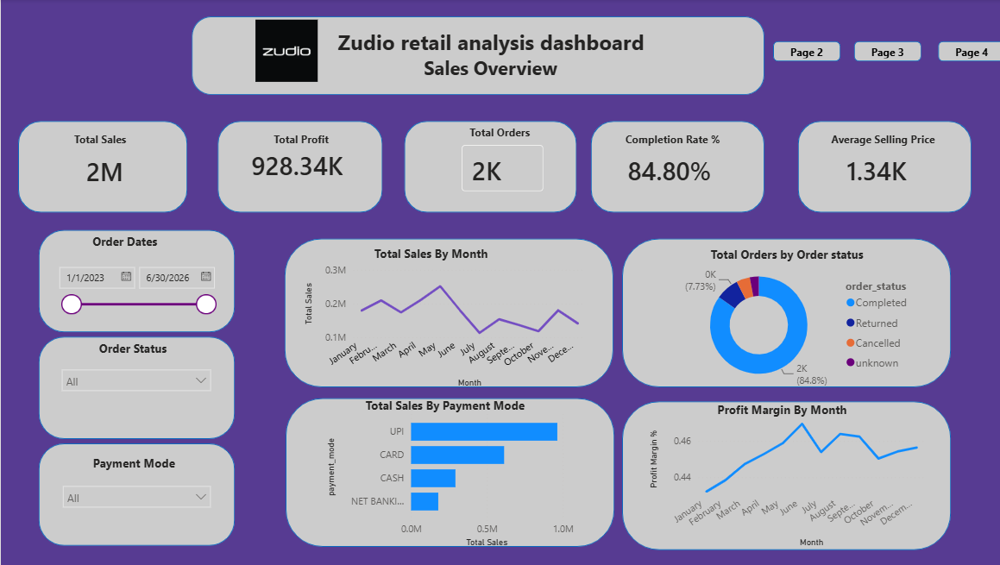
Dashboard 1 — Sales Overview
A high-level view of the whole business: sales, profit, and order health in one place.
Business question: How is the overall business performing?
Measures used: Total Sales • Total Profit • Total Orders • Completion Rate % • Return Rate % • Average Selling Price • Profit Margin %

Slide 7
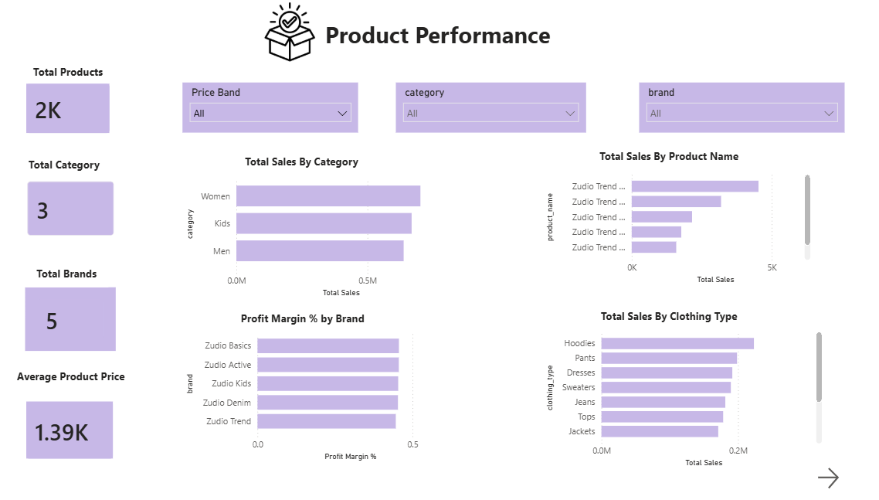
Dashboard 2 — Product Performance
Compares products, categories, and brands to see what is actually selling well.
Business question: Which products, categories, and brands are performing well?
Measures used: Total Products • Total Categories • Total Brands • Average Product Price • Total Sales • Profit Margin %

Slide 8
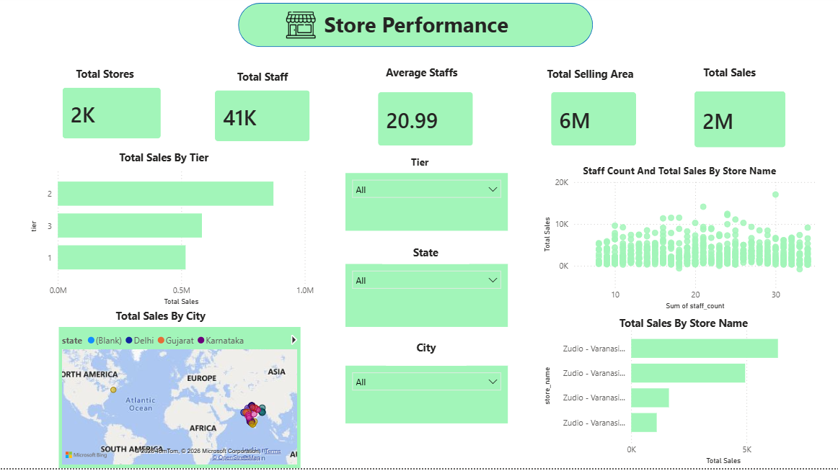
Dashboard 3 — Store Performance
Compares stores against each other — by tier, location, staff, and sales.
Business question: Which stores are performing better, and how are store factors related to sales?
Measures used: Total Stores • Total Staff • Average Staff per Store • Total Selling Area • Total Sales

Slide 9
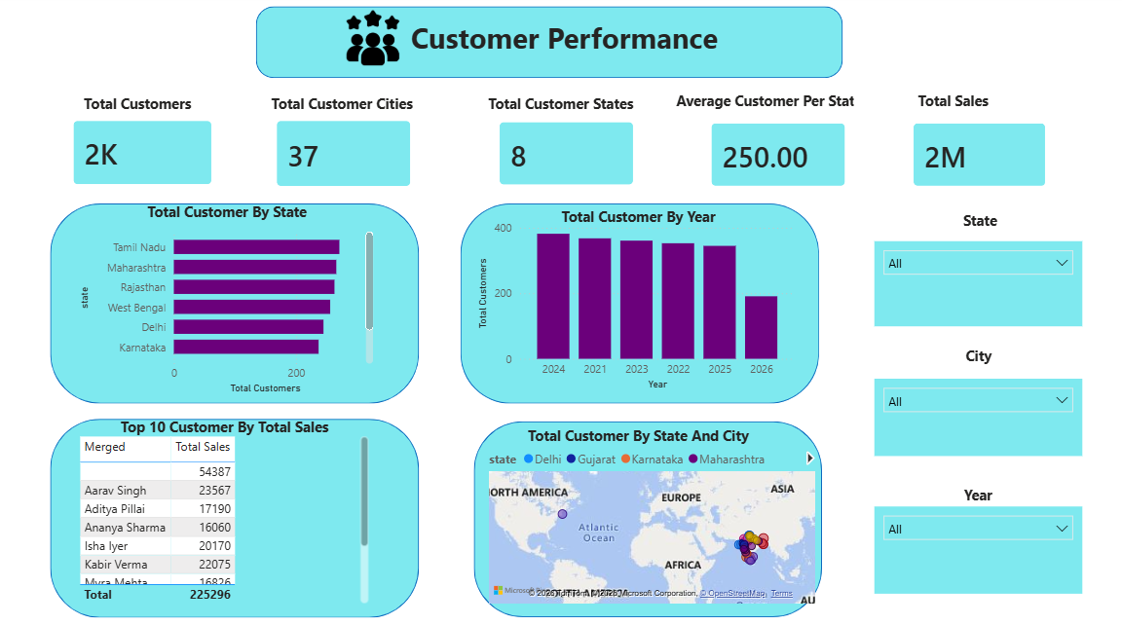
Dashboard 4 — Customer Insights
Shows who the customers are, where they come from, and how they shop.
Business question: Who are the customers, and how are they interacting with the business?
Measures used: Total Customers • Total Customer Cities • Total Customer States • Average Customers per State • Total Sales

Slide 10
Key insights and conclusion
See which products and categories bring in the most sales
Compare high- and low-performing stores
Track order status and payment method trends
Understand where customers come from and how they shop
Collect Data → Clean Data → Build SQL Database → Connect Tables → Create Measures → Build Dashboards → Get Insights
Conclusion
This project shows how SQL and Power BI work together to turn raw retail data into a clear, useful dashboard. Splitting the analysis into Sales, Products, Stores, and Customers makes it much easier to understand how the business is doing — and to make better decisions from it.
Thank you

